Slide 1
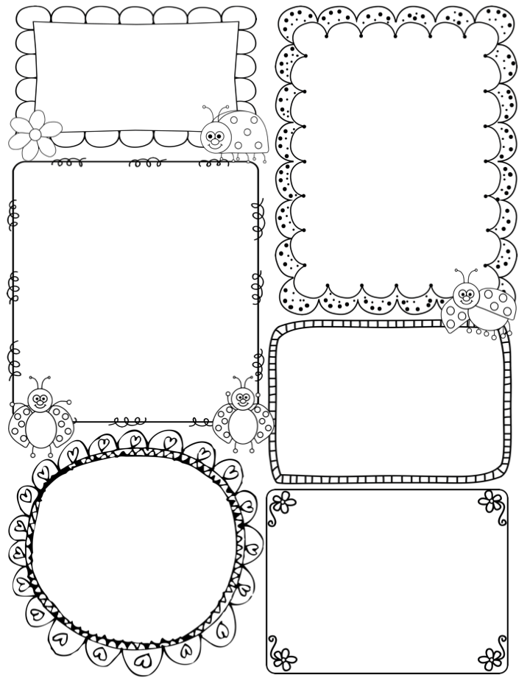
Ms. Cindy’s Newsletter
Feb 20-24
cindy.smith@jonesboroschools.net
870-780-4527
*Practice telling time to the nearest 5 min
*Counting up with coins
*Determine the best measurement tool
Our Class will perform
The Jungle Book Sunday, February 26.
Spelling Words
Test will be given each Friday
Closed Syllables patterns
band grand will camp sand stand stamp still pill pick stick lick crush dump lump flock
Sight words
almost animal every
few group might
Math
*Solve word problems involving quarters, dimes, nickels, and pennies
*Estimate length using inches, feet, centimeters and meters
*Tell and write time from an analog and digital clock to the nearest 5 minutes
Language
Irregular plural nouns
(e,g, feet, children, teeth, mice, fish )
Read aloud
Cloudy With a Chance of Meatballs
Vocabulary:
stale incident assorted prediction prepared accompanied
Test Thursday

